Slide 1
On behalf of
Department of Physical Education

Slide 2
It is indeed a proud moment to I present a brief report of the activities and achievements of the Department of Physical Education and Sports for the year 2022-23
Vision
Strive for "Mass Participation" of students in Games and Sports (Physical Activities) to develop Personal Health, Fitness and Social qualities which will enable them to become worthy citizens of India and to produce State, National and International level players.
Mission
“Games and Sports are the important Dimensions of quality of an Institution of Higher Learning”.
Let the youth realize that “Body is the medium of all the Goals”. Body should be strong to achieve heights in any sphere of life.
To make youth aware of the importance of Games and Sports (Physical Activities) in the overall development i.e. Physiological, Psychological, Mental, Social and Spiritual.

Slide 3
Objective
To motivate Students to achieve Health, Fitness & Social qualities.
Special efforts to take Games & Sports to the Tribal Areas which dominate the university jurisdiction in order to harness & develop physical skills & capabilities of tribal Students.
To achieve excellence in sports performance
Create standards Sports Infrastructure.

Slide 4
Physical Education Director :
Name | OMKARAPPA G
Date of joining | JUNE 01 2022
Educational Qualification | BPEd,MPed,PGD YOGA,KSET
KSLU Team Section Committee member 2022 | All Inter University yoga,
Associate NCC Officer | Completed Officer Training at Maharashtra Comptee

Slide 5
ACTION – PLAN
Coaching on a regular and continuous basis.
More intense training during the days leading up to important events.
Supplying uniform to athletes
Taking them to competitive meets at district, university, state and National level.
Giving incentives and encouragement to all those who represent the College at sport-meets at different levels irrespective of their winning prizes or not.
Extending first aid facilities to players.
Felicitating the best out going athletes.
Organized Mysore university inter college zonal cross country
meet and women games

Slide 6
Sports events Available in college
OUTDOOR | INDOOR
VOLLEYBALL | GYM
KABADDI | YOGA
BALL BADMINTON | CAROM
ATHLETICS | CHESS
SHUTTLE BADMINTON | KARATE
CRICKET
FOOTBALL
THROW BALL

Slide 7
SPORTS PARTICIPATION
Team &individual participation in Bangalore University Inter Collegiate, state, national Tournaments & selections -2023-24
Sl. No. | GAME /EVENT | MEN Team | WOMEN team
01 | Athletics | . | .
02 | Karate |  | .
03 | HAND BALL
04
05

Slide 8
National and international Level – Achievement
Date | Tournaments | Organised By | Event | Result | Participant
JULY 19.2023 | 10 meters air rifle event | TIRUVANANTAPURAM DIRECTORATE | SHOOTING | SILVER MEDAL | SUJAL SANKHALA 3RD BA
Aug 19-2023 to -22-2023 | Inter national | Bali badung Internationa open tournament indoneshya | KATATE | Gold medal | Sujal J Shetty from 2nd BA
Dec 26.2023 to 29. 2023 | SOUTH WEST ZONE National | TN PES CHENNAI | ATHLETIC CHAMPI | PATICIPATED | FAZAL S NADAF 2ND BCOM
Jan 10-2024 to jan 14-2024 | NATIONAL | SELAM UNIVERSITY TAMILNAD | HAND BALL | PARTICIPATED | CHANDANA 2ND BA SAAKSHI PATIL 1ST BA
NOV 1ST 2023 TO NOV 10TH NOV | ALL INDIA G.V MAVLANKAR SHOOTING COMPETITION | NATIONAL SHOOTING ASSOCIATION OF INDIA | SHOOTING | SILVER MEDAL | SUJAL SANKHALA 3RD BA
10-AUG .2023 | NATIONAL LEVEL | Held at New Delhi | Tent pitching AND Optical Training. | Got Gold medal and Got bronze Medal | FAZAL S NADAF 2ND BCOM

Slide 9
University and inter university Level – Achievements 2023
Bangalore University Inter college and Inter University
Women Category
Even | Prizes Secured
Athletic | 200M WOMEN 3RD PLACE 400 M MEN 2ND PLACE 4X400 2ND PLACE
ATHLETIC | SOUTH ZOME NATIONAL SELECTED IN 400M AND 4X400 RELAY EVENT
HAND BALL | INTER UNIVERSITY SOUTH ZONE NATIONAL HAND SELECTED

Slide 10
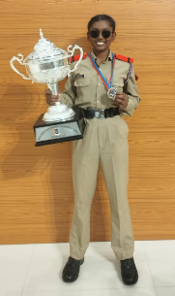
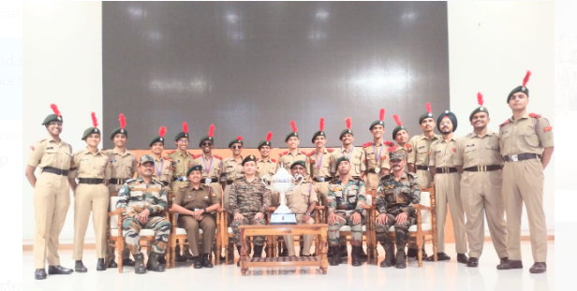
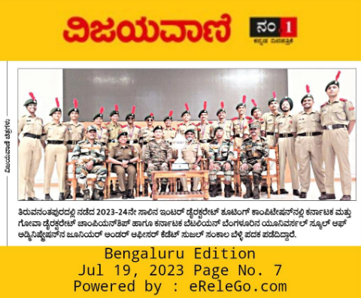
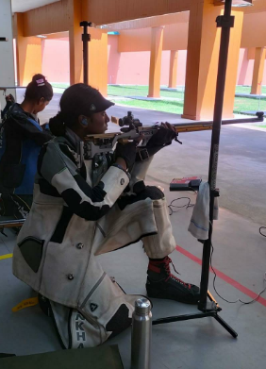
KARNATAKA & GOA DIRECTORATE INTER DIRECTORATE SPORTS SHOTING COMPETITIONS
Universal School of Administration NCC Unit 5/2 coy Army Cadet JUO Sujal Sakhala Represented Karnataka & Goa Directorate in Inter directorate sports shooting competition 2023 held at Thiruvananthapuram, (Kerela) conducted by Kozhicode NCC group of Kerala and Lakshadweep Directorate and won Silver medal in the 10 meters air rifle event. Out of 17 directorates of NCC , the Karnataka & Goa directorate won the overall chairmanship of IDSSC 2023.

Slide 11
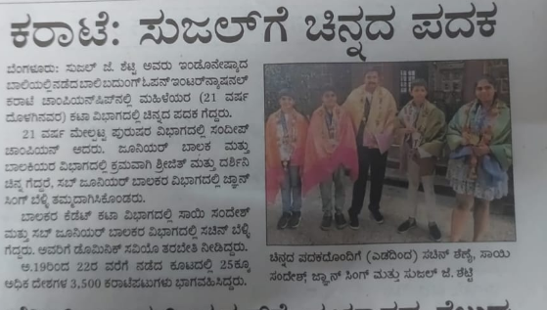
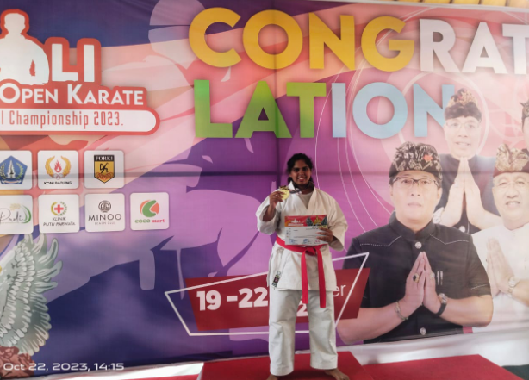
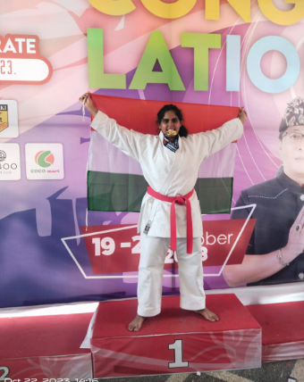
INTERNATIONAL OPEN KARATE CHAMPIONSHIP-2023
Gold Glory for Sujal J Shetty in Open International karate Championship!
We are proud to share the victory of Sujal J Shetty, a standout talent from the 3rd semester BA program at Universal School of Administration. At the Open International karate Championship on October 19 to 22 2023, at kali badung indoneshya , Sujal’s exceptional performance in the 68+ (kgs) category earned her the coveted Gold Medal.

Slide 12
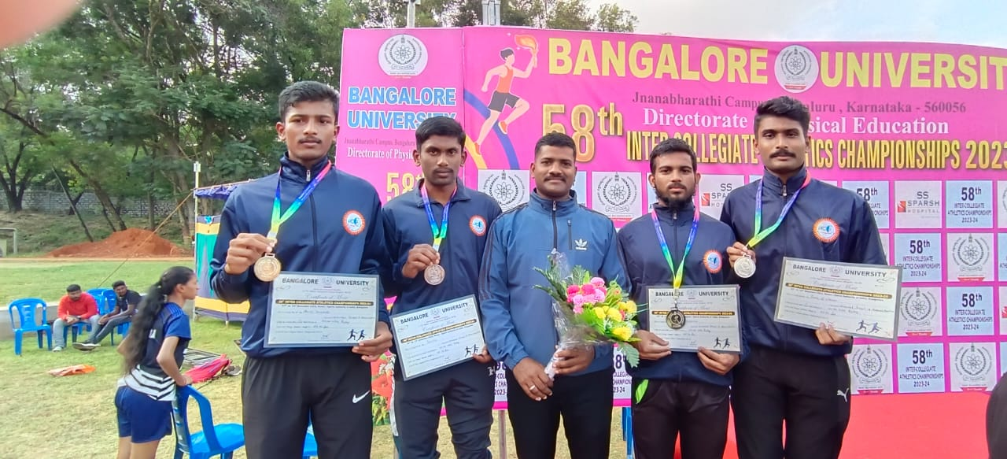
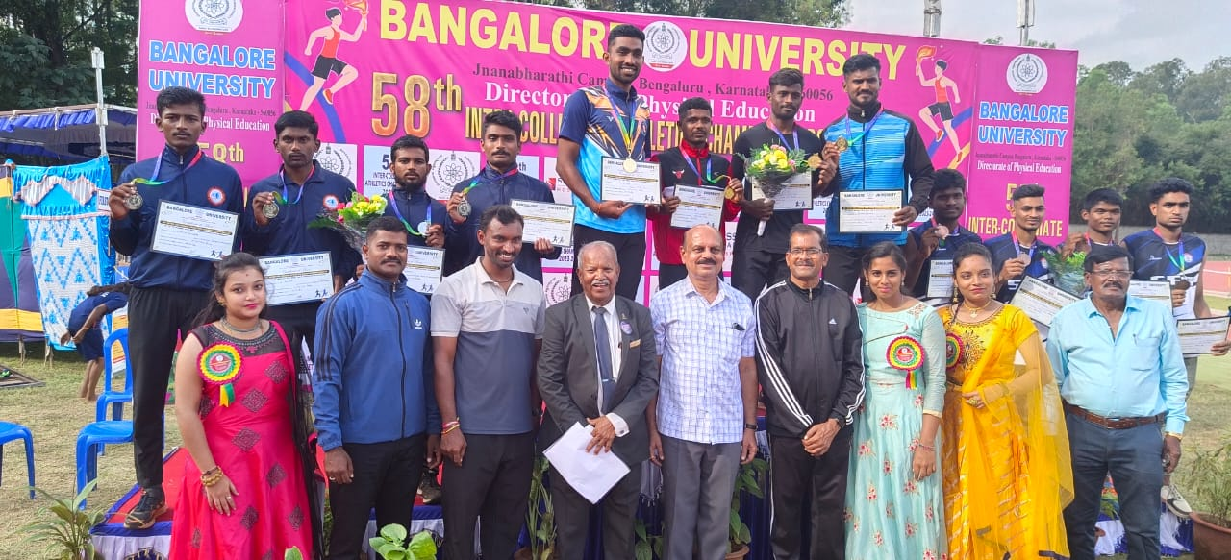
Inter-Collegiate Athletic championship
Fazal S Nadaf from I sem BA,Amith hukkeri Ist BA,Najee 1st BA,Jeevith 1st Bcom,Ankitha 1st BA, of Universal School of Administration, participated in the 58th Inter-collegiate Bangalore University Athletic Championship held from 22th to 24th Dec 2023 at SAI Sports Ground, Bangalore. Fazal S Nadaf he has won Second position in 400m and 4X400 Relay Events Jeevith,Najeer,Amith hukkeri has won second position in 4X400 Relay Event.Ankitha won 3rd position in 200m running Event.

Slide 13
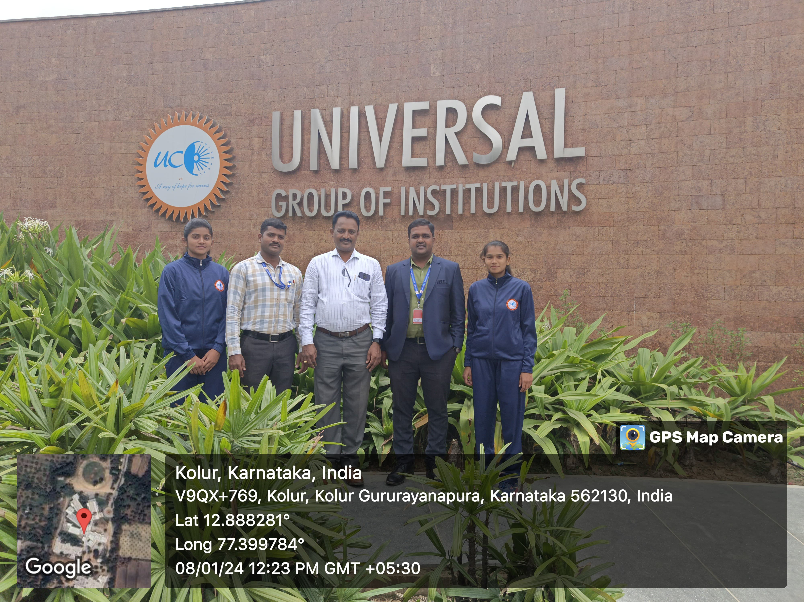
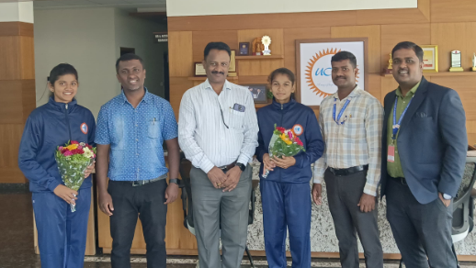
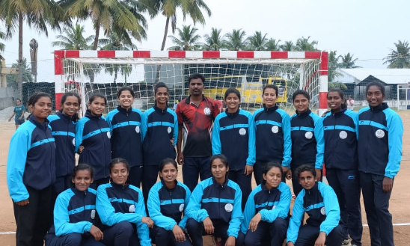
SELECTED FOR INTER UNIVERSITY NATIONAL HAND BALL SPORTS
We are proud to inform that two students of Universal School of Administration Ms Chandana second BA and Ms Sakshi Patil first BA represented Bangalore University and participated in the Inter University National level handball sports competition held at Salum from 10th to 14th January 2024 the event was organised by Periyar University Tamilnadu.

Slide 14
Bangalore University Inter Collegiate karate championship men and women 2023-24
Gold Glory for Sujal J Shetty in University Karate Championship!
We are proud to share the victory of Sujal J Shetty, a standout talent from the 3rd semester BA program at Universal School of Administration. At the University Inter-collegiate Karate Championship on January 2, 2024, at Government First Grade College Channapattana, Sujal’s exceptional performance in the 68+ (kgs) category earned her the coveted Gold Medal.
This success propels Sujal to the National Level Inter-University Championship, representing Bangalore University. Additionally, she’s set to compete in the prestigious Khelo India, a national-level grassroots games organized by the Ministry of Youth Affairs and Sports, Government of India.
Let’s celebrate Sujal’s dedication and skill, wishing her continued success on the national stage!

Slide 15
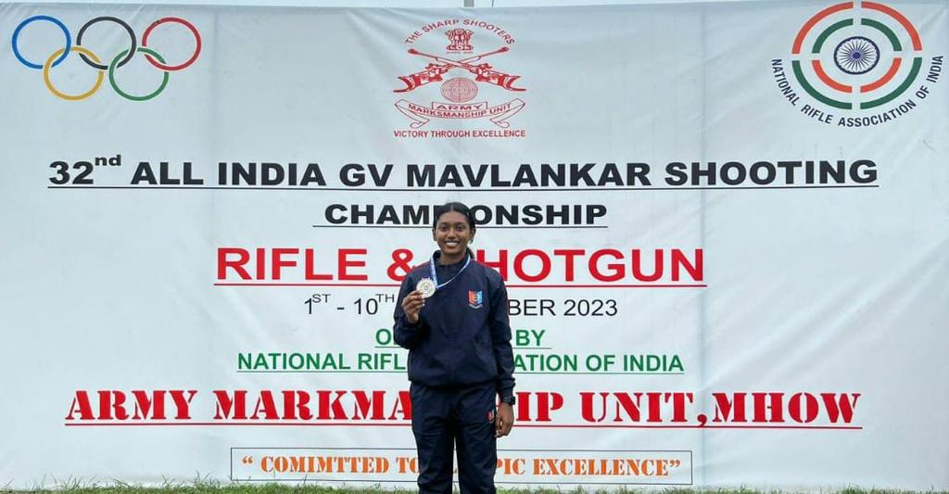
ALL INDIA G.V MAVLANKAR SHOOTING COMPETITION
Universal School of Administration NCC Unit 5/2 coy Army Cadet JUO Sujal Sakhala Represented the DG NCC in The All india G.V Mavlankar shooting competition conducted by National Rifle Association of India (NRAI) and won silver medal, in 3Position junior women rifle event held at Army Marksmanship Unit, MHOW, Indore (M.P).

Slide 17
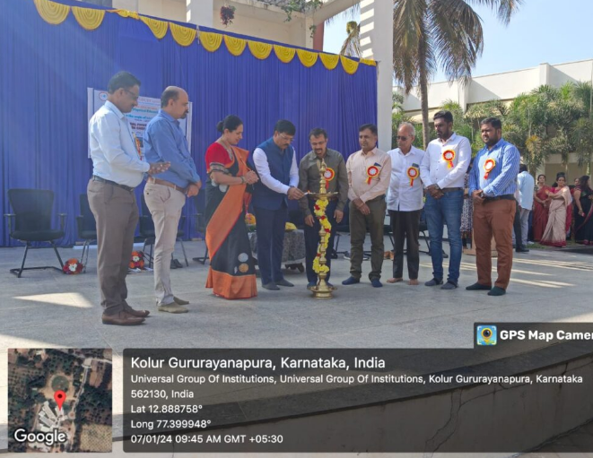
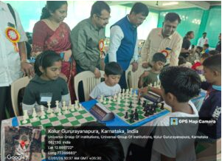
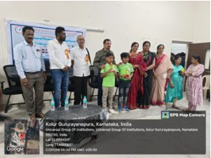
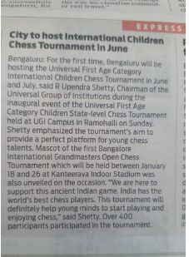
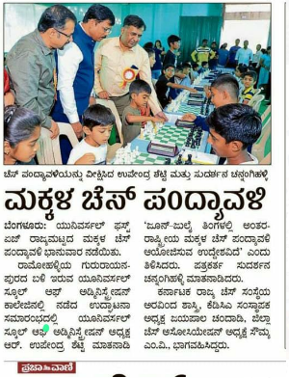
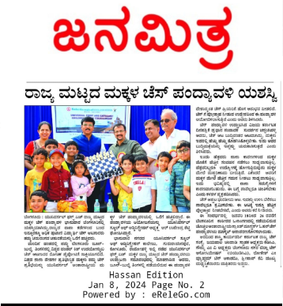

Slide 18
“Universal School of Administration Successfully Hosts State-Level Children Chess Tournament;
The Universal School of Administration, Bengaluru, took a significant stride in promoting chess at the grassroots level by hosting the State-level Children Chess Tournament on January 7th. Shri R. Upendra Shetty, Chairman of the Universal Group of Institutions, announced during the inaugural event that the institution will be making history by hosting the Universal First Age Category Children Chess Tournament, scheduled for January 7th.
Universal School of Administration emphasized the tournament’s pioneering objective to provide an ideal platform for budding chess prodigies, fostering their love for this ancient Indian game. Highlighting India’s global prominence in chess, USA expressed the belief that this tournament would encourage young minds to delve into and relish the complexities of chess. The tournament, held at the Universal Group of Institutions Campus in Ramohalli, witnessed an impressive turnout with over 400 enthusiastic participants.
This initiative not only underscores the Universal School of Administration’s commitment to nurturing talent but also aligns with the broader vision of promoting chess as a sport. By organizing these tournaments, the institution aims to contribute to the development of young minds, fostering a passion for chess and creating a thriving community of chess enthusiasts.

Slide 19
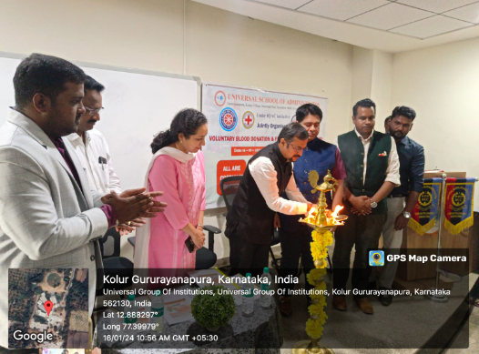
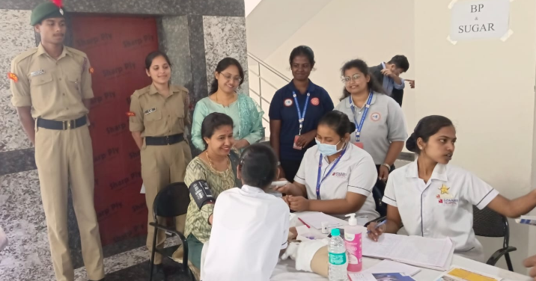
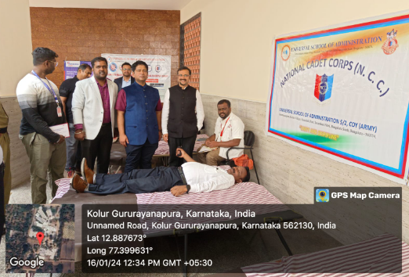
“Universal School of Administration’s Founders Day medical camp and Blood donation camp :
The NCC AND NSS Unit of the Universal School of Administration took center stage by organizing a voluntary Blood Donation Camp, a noble initiative conducted in association with Narayana Hrudayalaya, Sparsh Hospital, and the Indian Youth Redcross Wing. Under the watchful eye of the Honourable Chairman, Shri R Upendra Shetty, and with the distinguished presence of Chief Guest Mr. Nethrapal IRS (Addi. Commissioner Income Tax), the NCC Volunteers enthusiastically participated, with over 400 individuals contributing to the success of the camp. This event not only adhered to the principles of NCC but also reflected a positive, service-oriented approach towards society.
The formal ceremony that unfolded showcased enlightening speeches by Mr. Nethrapal IRS and Shri R Upendra Shetty. Their words resonated with the gathered volunteers, offering valuable insights and sharing rich life experiences. The event truly became a platform for intellectual exchange and motivation, fostering a sense of responsibility and community engagement among the participants. Amidst the felicitation, Santosh Shetty, the esteemed Administrator, took the stage to share insights about the organization’s journey and its unwavering commitment to excellence. His words resonated with gratitude and pride, acknowledging the collective efforts that have propelled the institution forward. The event served as a fitting tribute to these remarkable individuals, underscoring the pivotal roles they have played in shaping the organizational ethos and fostering a culture of growth and achievement.

Slide 20
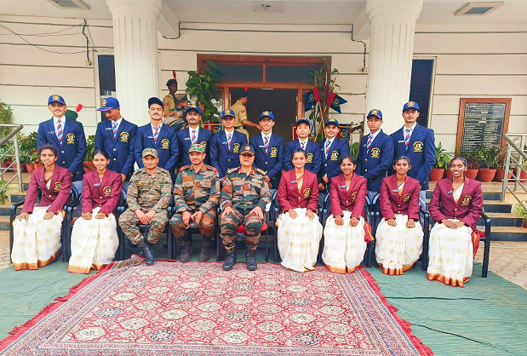
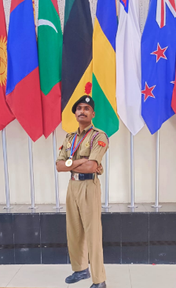
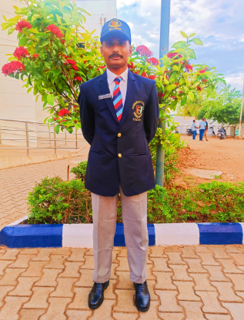
ALL INDIA THAL SEINIK CAMP
Univerzal School of Administration. Cadet FAZAL S NADAF Represented All India Thal senik Camp. Held at New Delhi got Gold medal in Tent pitching and Got bronze Medal in Optical Training.

Slide 21
Department Programs :
Intramural Chess competition

Slide 22
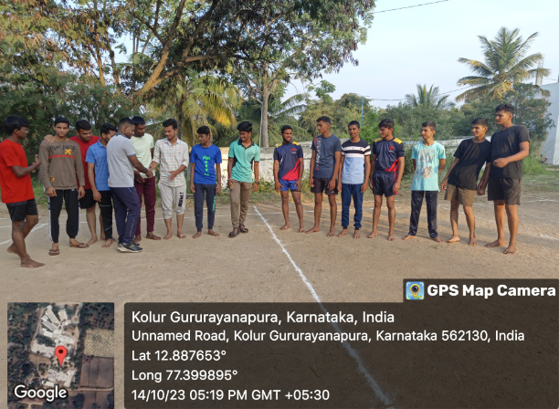
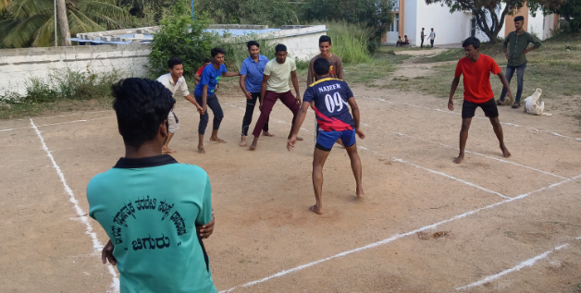
INTRA-COLLEGE KABADDI EVENTS COMPETITION

Slide 23
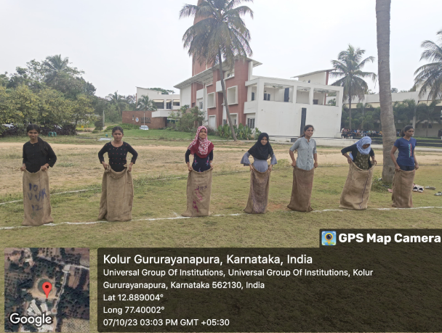
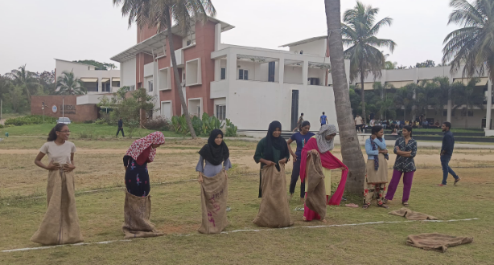
INTRA-COLLEGE SACK RACE EVENTS COMPETITION

Slide 24
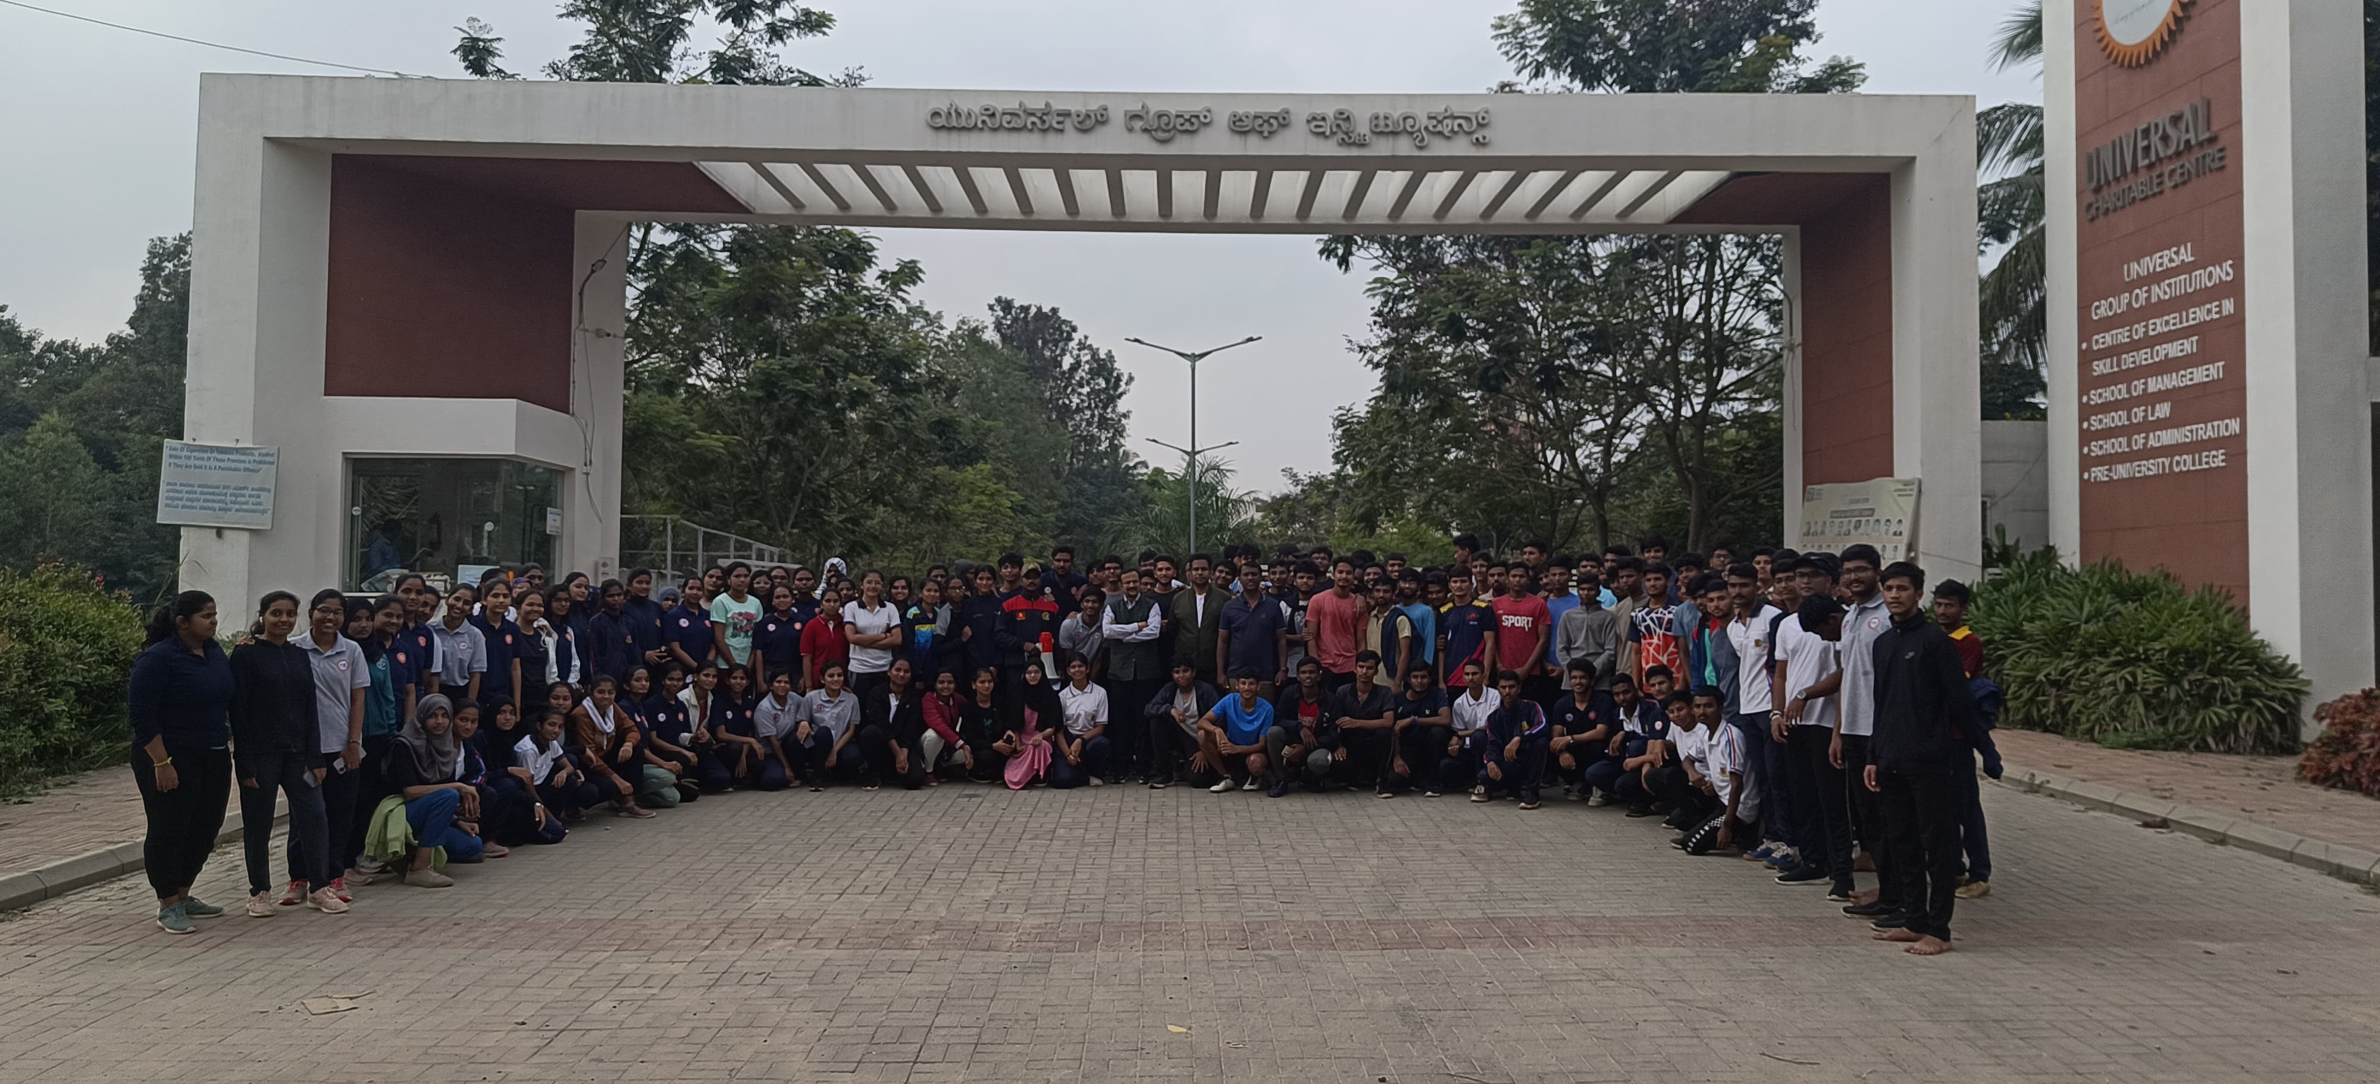
INTRA-COLLEGE WALKING RUNNING EVENTS COMPETITION
Universal Group of Institution Conducted INTRA-COLLEGE WALK and RUNING Men and Women 2023-24, on behalf of Human rights day. The programme was Held on Dec,09,2023 ..

Slide 25
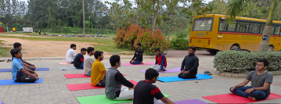
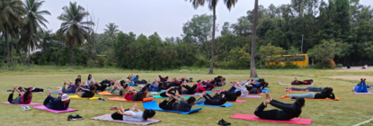
YOGA

